Slide 1

Operating Systems
Designed by Mr. M Mudassar

Slide 2
Outline
Process
Threads
CPU Scheduling
Process Synchronization
Deadlocks
Memory Management
Virtual Memory
File System
I/O System
Disk Management
Protection
Security

Slide 3
CPU Scheduling
…
Load store
Add store
Read from file
Store increment
Index
Write to file
…
CPU Scheduler
Select a process for execution
Scheduling decision will require:
Switches from running to waiting state
Switches from running to ready state
Switches from waiting to ready state
Terminates
Scheduling under 1 and 4 is non-preemptive
All other scheduling is pre-emptive
CPU burst
I/O burst
CPU burst
I/O burst
Wait for I/O
Wait for I/O

Slide 4
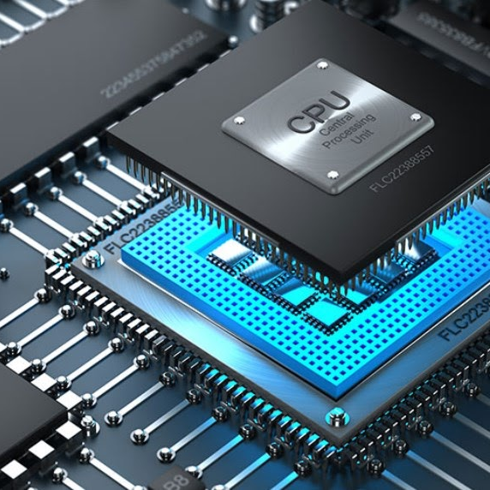
CPU Scheduling
Scheduling types
Pre-emptive
Non-pre-emptive
General goals of CPU Scheduling
Fairness
Policy enforcement
Efficiency
Response time
Turnaround time
Throughput
Dispatcher
The dispatcher should be as fast as possible since it is invoked in every process switch
Dispatch latency should be minimum
Scheduling criteria
CPU utilization
Throughput
Turnaround time
Waiting time
Response time
Realtime Scheduling
Hard real time system
Soft real time system

Slide 5
CPU Scheduling
Scheduling types
FCFS Scheduling
SJF Scheduling
Priority Scheduling
Round Robin Scheduling
Multilevel Queue Scheduling
Multilevel Feedback Queue Scheduling

Slide 6

CPU Scheduling
FCFS Scheduling Scheme
$Avg. wait time=\frac{0+24+27}{3}=\frac{51}{3}=17$ $Avg. Turnaround time=\frac{24+27+30}{3}=\frac{81}{3}=27$
$$Throughput=\frac{3}{30}=0.1$$
30 → 3
1 → 3/30
Process | Burst Time
P1 | 24
P2 | 3
P3 | 3
Gant chart using FCFS:
P1
P2
P3
0 24 27 30

Slide 7


CPU Scheduling – SJF Scheduling Scheme
Process | Arrival Time | Burst Time
P1 | 0 | 7
P2 | 2 | 4
P3 | 4 | 1
P4 | 5 | 4
Non-Pre-emptive Scheduling
$$Avg. wait time=\frac{\left(0−0\right)+\left(8−2\right)+\left(7−4\right)+(12−5)}{4}=\frac{16}{3}=4$$
$$Avg. turnaround time=\frac{\left(7−0\right)+\left(12−2\right)+\left(8−4\right)+(16−5)}{4}=\frac{32}{4}=8$$
Throughput = 4/16=0.25
P1
P3
P2
P4
0 7 8 12 16

Slide 8

CPU Scheduling – SJF Scheduling Scheme
Pre-emptive Scheduling
$$Avg. wait time=\frac{\left(11−2−0\right)+\left(5−2−2\right)+\left(4−4\right)+(7−5)}{4}=\frac{12}{4}=3$$
$$Avg. turnaround time=\frac{\left(16−0\right)+\left(7−2\right)+\left(5−4\right)+(11−5)}{4}=\frac{28}{4}=7$$
Throughput = 4/16=0.25
Process | Arrival Time | Burst Time
P1 | 0 | 7
P2 | 2 | 4
P3 | 4 | 1
P4 | 5 | 4
P1
P2
P3
P2
P4
P1
0 2 4 5 7 11 16

Slide 9

CPU Scheduling – Priority Scheduling Scheme
Process | Burst Time | Priority
P1 | 10 | 3
P2 | 1 | 1
P3 | 2 | 4
P4 | 1 | 5
P5 | 5 | 2
Starvation problem in SJF
Aging is the solution under priority scheduling scheme
$$Avg. wait time=\frac{6+0+16+18+1}{5}=\frac{41}{5}=8.2$$
$$Avg. turnaround time=\frac{16+1+18+19+6}{5}=\frac{60}{5}=12$$
Throughput = 5/19=0.26
P2
P5
P1
P3
P4
0 1 6 16 18 19

Slide 10
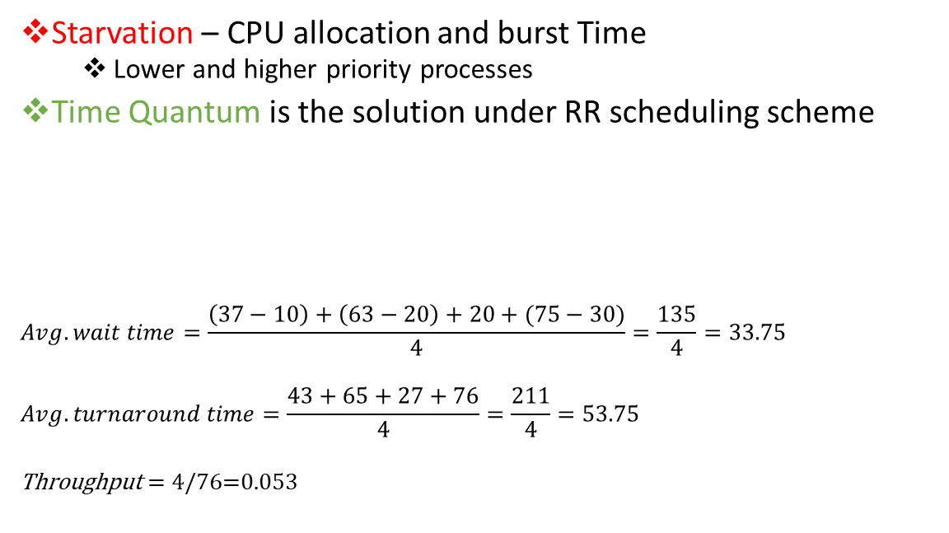
CPU Scheduling – Round Robin (RR) Scheduling Scheme
Quantum = 10 units
Starvation – CPU allocation and burst Time
Lower and higher priority processes
Time Quantum is the solution under RR scheduling scheme
$$Avg. wait time=\frac{\left(37−10\right)+\left(63−20\right)+20+(75−30)}{4}=\frac{135}{4}=33.75$$
$$Avg. turnaround time=\frac{43+65+27+76}{4}=\frac{211}{4}=53.75$$
Throughput = 4/76=0.053
Process | Burst Time
P1 | 16
P2 | 22
P3 | 7
P4 | 31
P1
P2
P3
P4
P1
P2
P4
P2
P4
P4
0 10 20 27 37 43 53 63 65 75 76

Slide 11
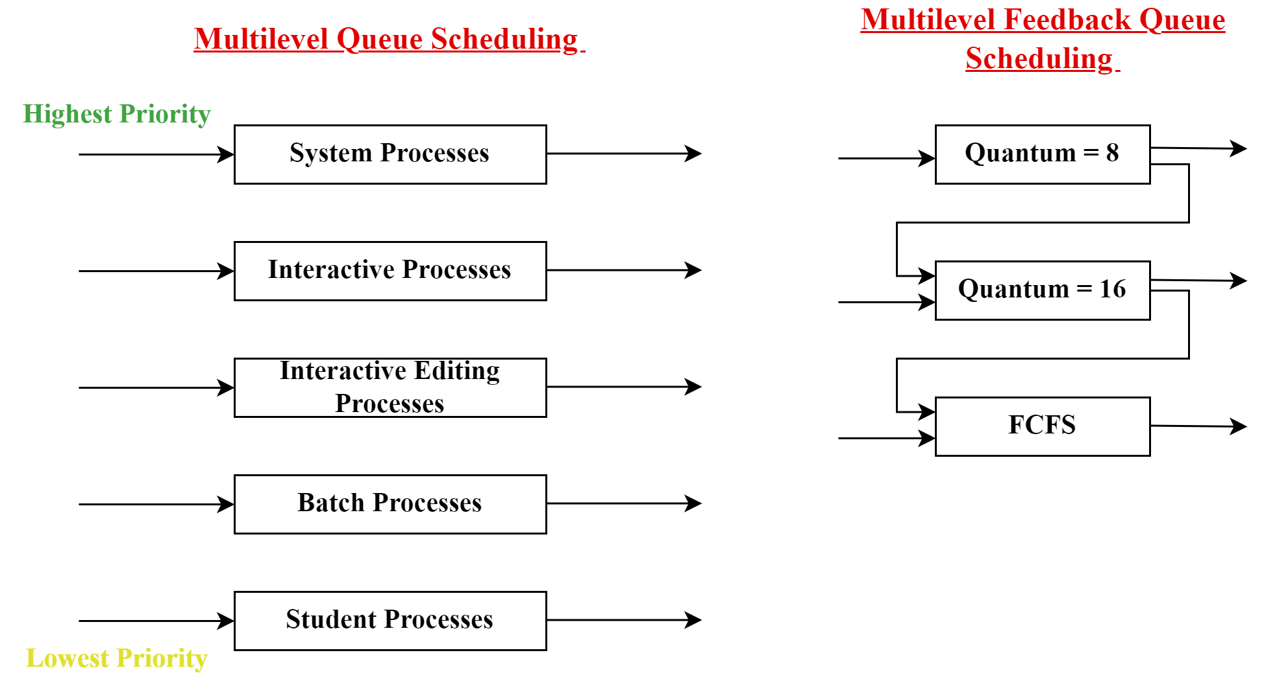
CPU Scheduling – Queue Scheduling Schemes

Slide 12

References
https://youtu.be/PvsiPJkofcE
https://youtu.be/m89i34ejf3M
https://youtu.be/xJ7ggywrTzs
https://youtu.be/RtBkBtAUt_c
https://youtu.be/f4-hogdH2KM
https://youtu.be/GNTGgmmj66c

Slide 13
Thank You(Q & A)

